Slide 1
List everything you know or remember about Plate Tectonics
Bellwork 10-17-16

Slide 2
Objectives
Students will be able to identify how the earth is affected by long- term and short- term geological cycles and the influence of man.
SPI 7.7.5 Recognize that lithospheric plates on the scale of continents and oceans continually move at rates of centimeters per year. SPI 7.7.6 Describe the relationship between plate movements and earthquakes, mountain building, volcanoes, and sea floor spreading.
Success Criteria- I can describe tectonic plate movements. I can determine land features made by tectonic plate movements.

Slide 3
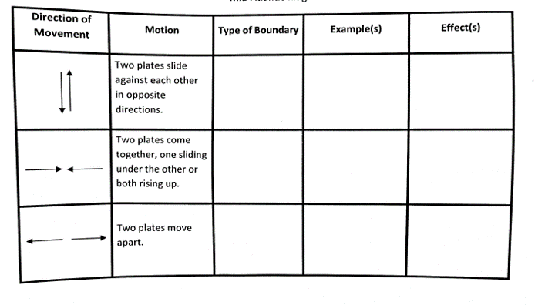
Copy this chart into your SN. If you finish a station early, work on filling out what you have learned!

Slide 4
Plate Tectonics Brain Pop
Plate Tectonics

Slide 5
Plate Tectonics Stations
You will have 12 minutes at each station.
We will complete 2 stations per day.
Make sure to fill in every spot on lab sheet that has a blank.
Jobs:

Slide 6
Exit Ticket- Answer on Post-It and stick on my closet door.
Which is most likely when two lithospheric plates pull apart?
A New sea floor will form.
B A hot spot will develop.
C An earthquake will occur.
D Metamorphic rock will form.

Slide 7
Describe the movement of a convergent boundary. What geological features can form at a convergent boundary?
Bellwork 10-18-16

Slide 8
Objectives
Students will be able to identify how the earth is affected by long- term and short- term geological cycles and the influence of man.
SPI 7.7.5 Recognize that lithospheric plates on the scale of continents and oceans continually move at rates of centimeters per year. SPI 7.7.6 Describe the relationship between plate movements and earthquakes, mountain building, volcanoes, and sea floor spreading.
Success Criteria- I can describe tectonic plate movements. I can determine land features made by tectonic plate movements.

Slide 9
Transform Boundaries
Type of boundary: Transform
Example(s): California's San Andreas fault
Effect(s): No lithosphere is created or destroyed, but sometimes the energy is released as an earthquake

Slide 10
Transform Boundary
San Andreas Fault

Slide 11
Plate Tectonics Stations
You will have 12 minutes at each station.
We will complete 2 stations per day.
Make sure to fill in every spot on lab sheet that has a blank.
Jobs:

Slide 12
Exit Ticket- Answer on Post-It and stick on my closet door.
At a transform boundary, tectonic plates are
A sliding under the ocean
B sliding past each other
C moving toward each other
D moving apart from each other

Slide 13
Describe a divergent boundary. What geological features take place here?
Bell work 10-19-16

Slide 14
Objectives
Students will be able to identify how the earth is affected by long- term and short- term geological cycles and the influence of man.
SPI 7.7.5 Recognize that lithospheric plates on the scale of continents and oceans continually move at rates of centimeters per year. SPI 7.7.6 Describe the relationship between plate movements and earthquakes, mountain building, volcanoes, and sea floor spreading.
Success Criteria- I can describe tectonic plate movements. I can determine land features made by tectonic plate movements.

Slide 15
Convergent Boundaries
Type of Boundary: Convergent
Example(s): Cascade Mountain Range
Effect(s): Mountains (plates are pushed together), trenches (one plate is subducted, or bent down under the other), volcanoes (magma rises at subduction zones and finds its way to the surface)

Slide 16
Convergent Boundaries
Mariana Trench

Slide 17
Plate Tectonics Stations
You will have 12 minutes at each station.
We will complete 2 stations per day.
Make sure to fill in every spot on lab sheet that has a blank.
Jobs:

Slide 18
Exit Ticket- Answer on Post-It and stick on my closet door.
Scientists theorize that the Atlantic Ocean is slowly increasing in width. Which is the best approximation of the rate at which lithospheric plates beneath the Atlantic Ocean are moving?
A 2 millimeters per year
B 2 centimeters per year
C 2 meters per year
D 2 kilometers per year

Slide 19
Describe a transform boundary. What geological feature occurs here?
Bell work 10-20-16

Slide 20
Objectives
Students will be able to identify how the earth is affected by long- term and short- term geological cycles and the influence of man.
SPI 7.7.5 Recognize that lithospheric plates on the scale of continents and oceans continually move at rates of centimeters per year. SPI 7.7.6 Describe the relationship between plate movements and earthquakes, mountain building, volcanoes, and sea floor spreading.
Success Criteria- I can describe tectonic plate movements. I can determine land features made by tectonic plate movements.

Slide 21
Divergent Boundaries
Type of Boundary: Divergent
Example(s): East Africa Rift
Effect(s): Rift valleys and sea-floor spreading

Slide 22
Divergent Boundaries
Mid Atlantic Ridge

Slide 23
Plate Tectonics Stations
You will have 12 minutes at each station.
We will complete 2 stations per day.
Make sure to fill in every spot on lab sheet that has a blank.
Jobs:

Slide 24
Exit Ticket- Answer on Post-It and stick on my closet door.
Which statement best describes the movement of Earth’s lithospheric plates?
A Sometimes the plates move, and sometimes they do not.
B Some plates move, but most do not.
C The plates moved in the past, but today they do not.
D The plates are always moving.

